Slide 1
Difference ET server for GPCR Class A at
http://mammoth.bcm.tmc.edu/gpcr/diff_GPCRA.html
Usage and architecture
Rhonald Lua et al

Slide 2
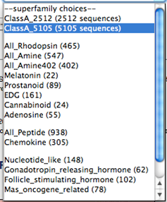
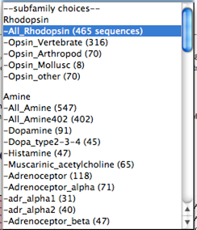
Step 1: Select the GPCR superfamily and subfamily sequence alignments from the drop-down boxes
Step 2: Hit or click "Submit"

Slide 3
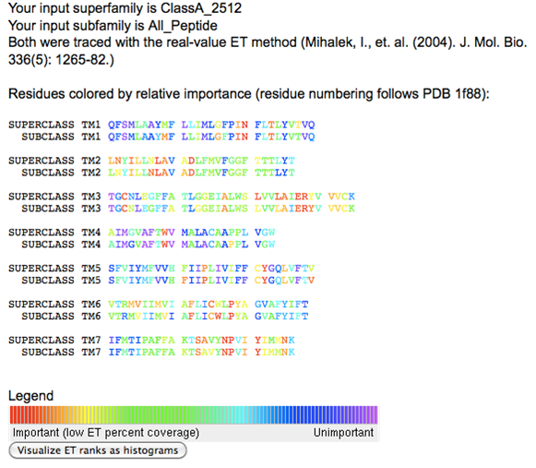
The output is a single webpage. Superfamily and subfamily trace results are mapped onto the protein sequence corresponding to the transmembrane domain. Links to multiple sequence alignments, Evolutionary Trace rank data files and PyMOL input files are also accessible from the tables (next slide).
Place the mouse pointer over the rainbow-colored residue symbols to view residue numbers following PDB 1f88 and
Ballesteros-Weinstein nomenclature.

Slide 4
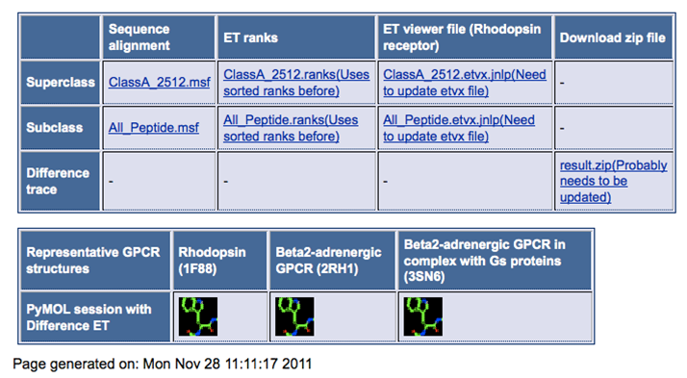
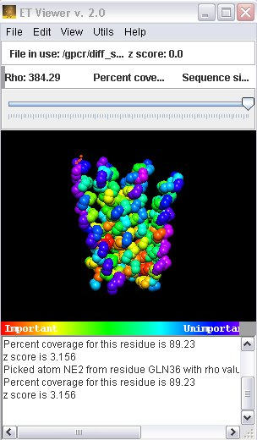
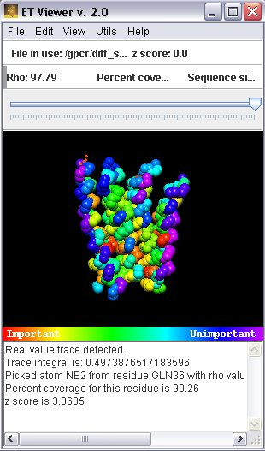
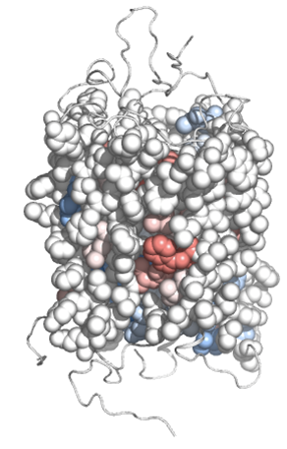
Web output (continued)
Click or download JNLP files to launch our ET Viewer
(http://mammoth.bcm.tmc.edu/traceview/index.html) and view structures, traces, trees and alignments for each family or class
Click or download PyMOL session files and view the structure with PyMOL

Slide 5
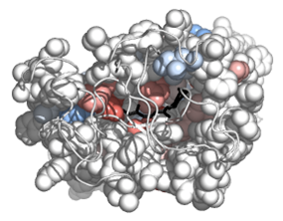
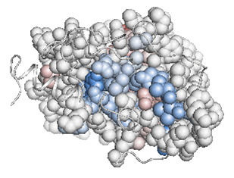
In the PyMOL session, colors on the transmembrane region (spheres) provide a snapshot of the difference ET between superfamily and subfamily (scheme suggested by AD Wilkins)
red hues (subfamily more important)
white
ET percentile rank differences
blue hues (superfamily more important)
top
bottom

Slide 6
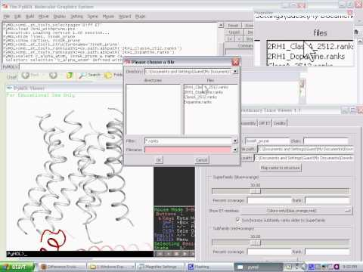
The presentation of Difference ET results on the structure can be customized by using the PyETV plugin, as demonstrated in the following video:

Slide 7
Program files that make the server work
Web portal (HTML):
http://mammoth.bcm.tmc.edu/gpcr/diff_GPCRA.html
CGI script (PERL)
http://mammoth.bcm.tmc.edu/cgi-bin/diff_ET/diffET_GPCRA.cgi
Supplementary(PERL, Python and C)
/var/www/EasyTrace/wetc
/var/www/html/uet/createPyMOLDiffET.py (create the pse files for the website)
/var/www/cgi-bin/makeJNLP/makeJNLPdiffGPCR.pl
/var/www/bin/changerankfile_1f88to2rh1.pl

